Slide 1
Lecture 7: Classifiers I
Intro to Data Science for Public Policy
Spring 2017
Jeff Chen + Dan Hammer

Slide 2
Roadmap
A Surprise
Motivation
Classification Preliminaries
Decision Trees
<Break>
Random Forests
Homework #3
Homework #4 – a head up
Intro to Data Science for Public Policy, Spring 2017

Slide 3
All completed class materials can now be downloaded here:
https://georgetownmccourt.github.io/data-science/
Surprise

Slide 4
Roadmap
A Surprise
Motivation
Classification Preliminaries
Decision Trees
<Break>
Random Forests
Homework #3
Homework #4 – a head up
Intro to Data Science for Public Policy, Spring 2017

Slide 5
Isn’t this little guy just so cute?
Source; Wikimedia commons
Motivation

Slide 6
Isn’t this little guy just so cute…?
Source; Wikimedia commons
Motivation

Slide 7
Not Sea Lion Pup
What’s the difference?
Sea Lion Pup
Source; Wikimedia commons
Motivation

Slide 8
Not Sea Lion Pup
What’s the difference?
Sea Lion Pup
Source; Wikimedia commons
Motivation

Slide 9
Not Sea Lion Pup
What’s the difference?
Sea Lion Pup
Source; Wikimedia commons
Motivation

Slide 10
Binary variable
One feature, two classes
Pup or Not?
Yea
Nay
Motivation

Slide 11
Binary variable
One feature, two classes
Whale?
Whale
Wave
Motivation

Slide 12
Binary variable
One feature, two classes
Fire risk?
It has burned before
It has not burned…yet
Motivation

Slide 13
Binary variable
One feature, two classes
School closure
Closed
Open
Motivation

Slide 14
Binary variable
One feature, two classes
Yankees v. Red Sox
Yankees
Red Sox
Motivation

Slide 15
Binary variable
One feature, two classes
Purchase Conversion
Buy given advert
No buy given advert
Motivation

Slide 16
Binary variable
One feature, two classes
Recidivate?
Yes
No
Motivation

Slide 17
Binary variable
One feature, two classes
Coffee
Starbucks
Peet’s
Motivation

Slide 18
Binary variable
One feature, two classes
Ice Cream
Chunky Monkey
Ameri-cone Dream
Motivation

Slide 19
Binary variable
One feature, two classes
Plane delay
Delay
On-time
Motivation

Slide 20
Binary variable
One feature, two classes
Voting
GOP
DEM
Motivation

Slide 21
Binary variable
One feature, two classes
Program adoption
Opt-in
Opt-out
Motivation

Slide 22
Binary variable
One feature, two classes
Insurance
Covered
Not covered
Motivation

Slide 23
Some of the most pressing questions can be answered by simply understanding why people, things, events fall into one group but not another.
This is called classification.
Motivation

Slide 24
Roadmap
A Surprise
Motivation
Classification Preliminaries
KNN: Part Deux
Decision Trees
<Break>
Random Forests
Homework #3
Homework #4 – a head up
Intro to Data Science for Public Policy, Spring 2017

Slide 25
Classifiers are a type of supervised learning problem that handles target features that contain discrete labels, otherwise known as classes.
Insurance
Covered
Not covered
Classification

Slide 26
Given a training set, a classifier or classification algorithm learns how input features are associated with each class.
Wage > Pov.
Age > 65
Age < 30
!Race
Non-Citizen
College deg.
< B.A.
Married
Covered
Not covered
Classification

Slide 27
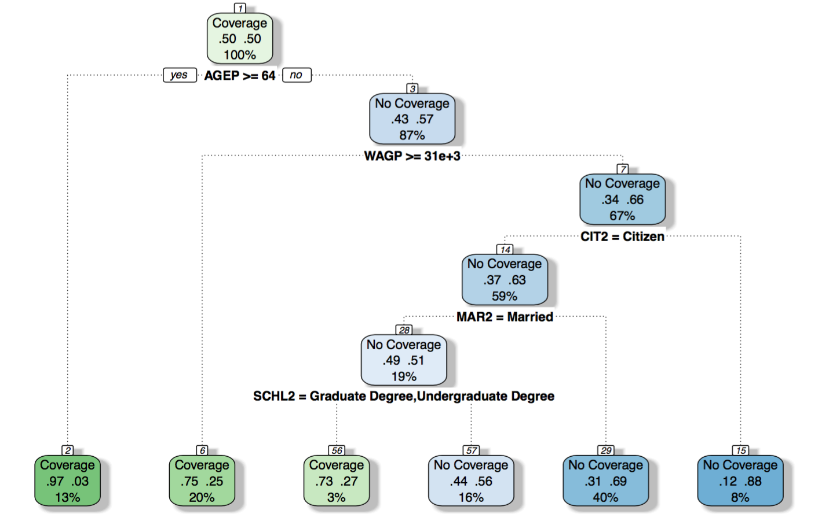
The algorithm may yield an equation, a series of equations or rules.
Classification

Slide 28
What are the differences between regression and classifiers?
Classification

Slide 29
What is the difference between
regressions and classifiers?
#1. The targets (Y) are different.
Regressions train on continuous features and return continuous predictions.
Classifiers train on discrete variables and can return a probability and/or a discrete prediction.
Classification

Slide 30
What is the difference between
regressions and classifiers?
#1. The targets (Y) are different.
Y = [0, 1.23, 525.2, 210, 0.53]
Y-hat = [0.4, 1.2, 450, 200, 0.4]
Y = [’yes’,‘no’,‘yes’,‘no’,‘no’,’yes’] = [1,0,1,0,0 ,1]
Y-hat = [0.89, 0.1, 0.6, 0.2, 0.4, 0.99]
Classification

Slide 31
What is the difference between
regressions and classifiers?
#2. The goals are different.
Regressions try to find which features move together.
Classifiers look for opportunities to maximize
separability.
Classification

Slide 32
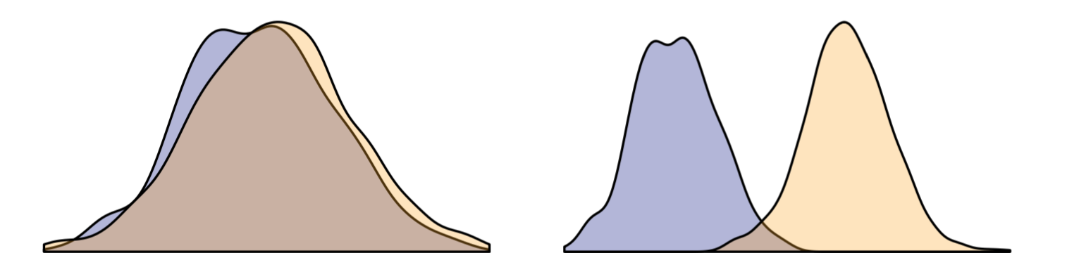
What is the difference between
regressions and classifiers?
Side bar: Separability is the extent to which two classes can be clearly identified using quantitative variables. Greater the separability, greater the accuracy of prediction.
Low Separability
High Separability

Slide 33
What is the difference between
regressions and classifiers?
#3. Accuracy metrics are different
Regressions are measured in terms of R-squared, F-statistics, RMSE, and MAPE.
Classifiers rely on measures that can
be derived from a confusion matrices.
Classification

Slide 34
What is the difference between
regressions and classifiers?
Side bar: What’s a confusion matrix?
 | PREDICT: TRUE | PREDICT: FALSE
ACTUAL: TRUE | TRUE POSITIVE (TP) | FALSE NEGATIVE (FN) | True Positive Rate (TPR) Aka Recall or Sensitivity TP/(TP+FN)
ACTUAL: FALSE | FALSE POSITIVE (FP) | TRUE NEGATIVE (TN) | False Positive Rate FP/(TN + FP)
 | Positive Predicted Value (PPV) or Precision TP/(TP+FP) | Negative Predicted Value (NPV) TN/(TN+FN) | % Accuracy (TP + TN)/ALL
Classification
Notes:
Add FPR to diagram

Slide 35
What is the difference between
regressions and classifiers?
Question: If a value is predicted to be TRUE, what should the cutoff threshold be?
Pr(Y) = [0.1, 0.2, 0.3, 0.4, 0.5, 0.7, 0.9, 1.0]
Classification

Slide 36
What is the difference between
regressions and classifiers?
Question: If a value is predicted to be TRUE, what should the cutoff threshold be?
Pr(Y) = [0.1, 0.2, 0.3, 0.4, 0.5, 0.7, 0.9, 1.0]
Threshold can be at any point!
Classification

Slide 37
What is the difference between
regressions and classifiers?
Question: What do we do with that fine nugget of confusing wisdom?
#A. Receiving Operating Characteristic Curve (ROC)
A plot of TPR and FPR tested at many thresholds between 0 and 1. The area under the dotted line ranges from 0.5 (coin toss accuracy) to 1.0 (perfect accuracy).
0 TPR 1
0 FPR 1
Classification

Slide 38
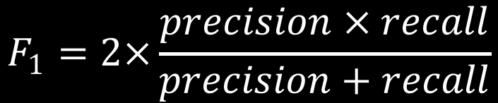
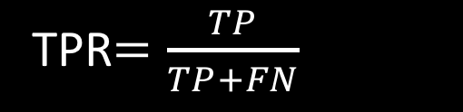
What is the difference between
regressions and classifiers?
Question: What do we do with that fine nugget of confusing wisdom?
#B. F1-Score
A ratio of recall and precision where 0 is a poor prediction and 1 is a perfect prediction. Best used if the sample is balanced.
$$F_{1}=2×\frac{precision × recall}{precision+recall}$$
TPR$=\frac{TP}{TP+FN}$
#C. True Positive Rate
Classification

Slide 39
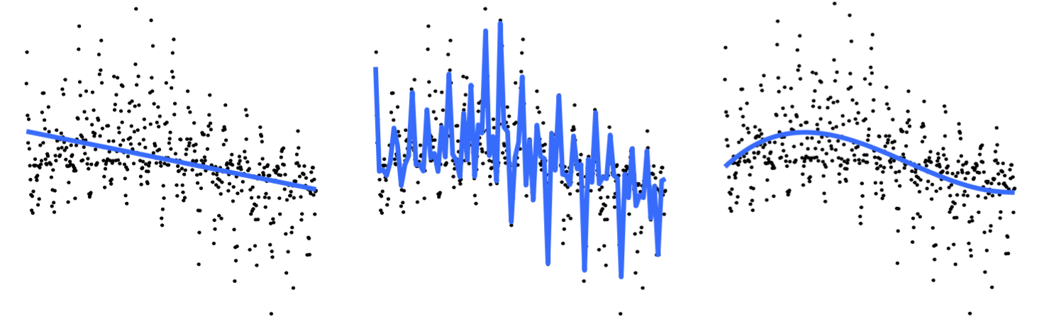
What is a common consideration for both
regressions and classifiers?
#1. The Bias-Variance Tradeoff
Bias is defined as the erroneous assumption of a model (e.g. overly simplistic, overly complicated). Variance is the error. In short user assumptions need to be gut checked.
Classification

Slide 40
What is a common consideration for both
regressions and classifiers?
#2. The Bias-Variance Tradeoff type of the model fits is likely to be found in a public policy setting and which in a tech startup?
Classification

Slide 41
Roadmap
A Surprise
Motivation
Classification Preliminaries
Decision Trees
<Break>
Random Forests
Homework #3
Homework #4 – a head up
Intro to Data Science for Public Policy, Spring 2017

Slide 42
Health insurance coverage is a problem in the United States. In some states, there are double-digit percentages of residents without coverage.
Decision trees

Slide 43
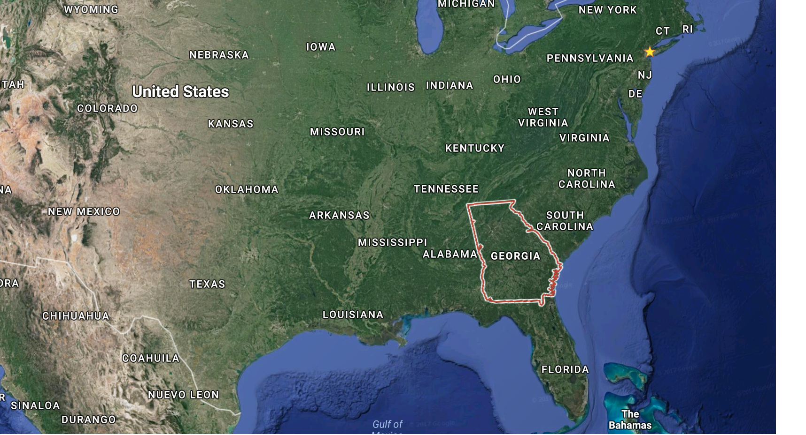
In 2015, about 16.5% of residents of the US State of Georgia were without coverage.
Decision trees

Slide 44
To get people registered and enrolled, 16.5% needs to be decomposed into targetable populations. But which?
Let’s say that:
Y(Coverage) = f(Marital Status, Age, Wage, Race, Education, Citizenship)
Decision trees

Slide 45
A decision tree subsets a population into smaller more homogeneous subpopulations using input features.
Decision trees

Slide 46
Root node
Parent
Child to
Vocab
Time!
Split
Edge
Leaf
Decision trees

Slide 47
Question: How does each variable get chosen? This can be as good as using a pivot table, right??
Decision trees

Slide 48
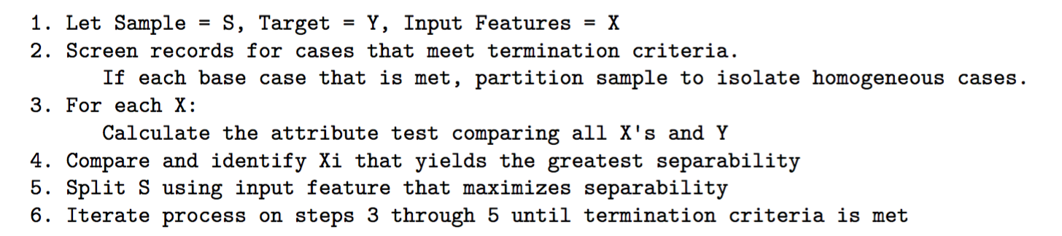
Decision tree algorithm
Decision trees

Slide 49
Decision tree algorithm
3. Starting from the root node
For each input feature:
Split node into two parts based on some threshold of a given input feature
Calculate an ”attribute test” for each input feature.
Store the result of the test
After all variables are tested, choose the variable with the best attribute test
Split node into two
If termination criteria is not met, repeat process on each node.
Decision trees

Slide 50
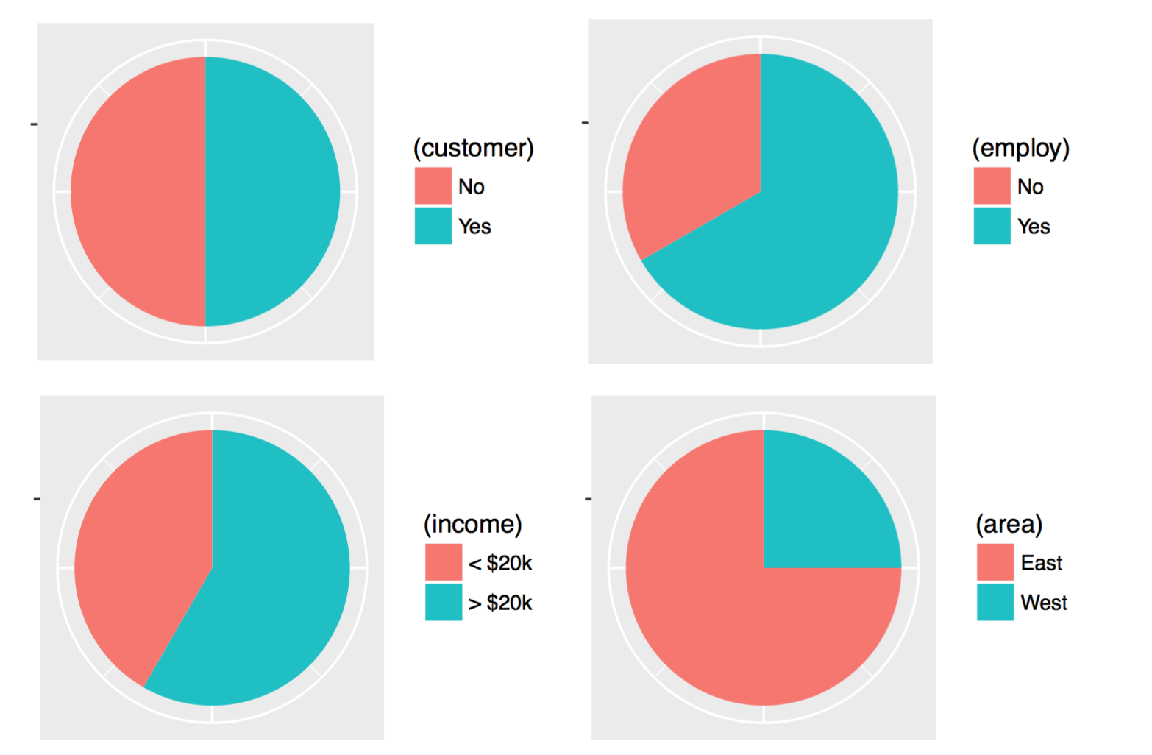
What’s an attribute test?
Scenario: Which feature is most associated with being a customer?
Decision trees

Slide 51
What’s an attribute test?
Upon calculating a cross-tab, which of the three plots provides the most information?
Decision trees

Slide 52
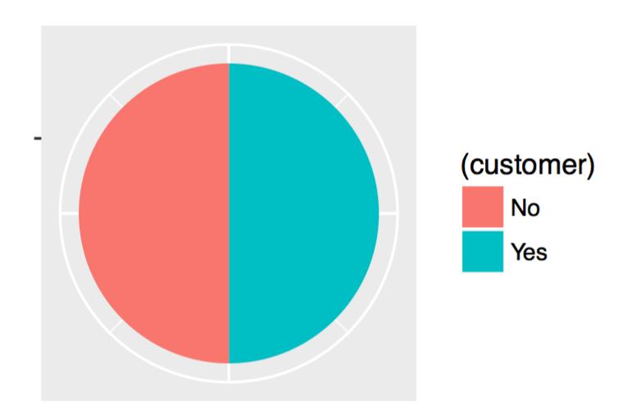
What’s an attribute test?
The goal of the attribute test is to find the feature that, when split into two subpopulations, yields the most information
Root Node
Decision trees

Slide 53
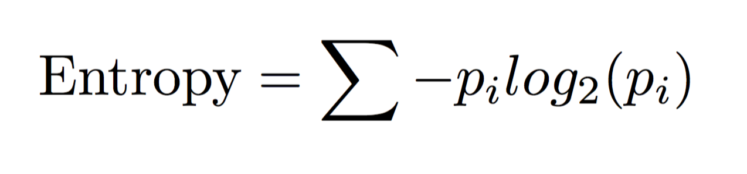
What’s an attribute test?
Entropy can be used to calculate consistency of information.
Where p is the proportion of a sample that is of class i.
Decision trees

Slide 54
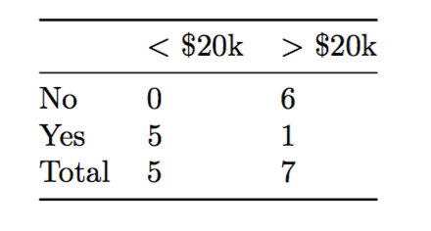
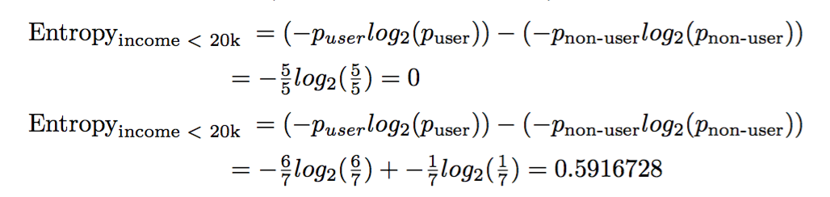
What’s an attribute test?
Example Calculation.
Decision trees

Slide 55
What’s an attribute test?
Entropy of each cross-tab
Entropy = 1
Entropy = 0.35
Entropy = 0.97
Decision trees

Slide 56
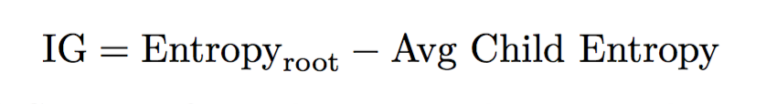
The actual attribute test is “Information Gain”?
Information Gain is a variant of entropy that compares the entropy of the root to the average entropy of child nodes
Decision trees

Slide 57
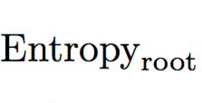
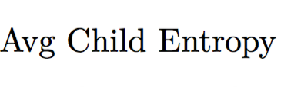
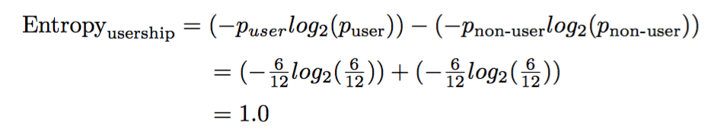
The actual attribute test is “Information Gain”?
Information Gain is a variant of entropy that compares the entropy of the root to the average entropy of child nodes
Decision trees

Slide 58
Income was the best option.
Root Node
Entropy = 0
Entropy = 0.65
Entropy = 0.03
Decision trees

Slide 59
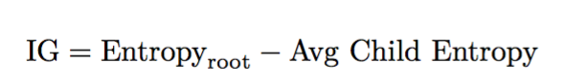
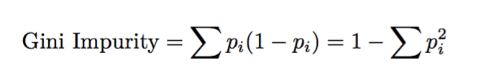
Other attribute tests can also include:
Decision trees

Slide 60
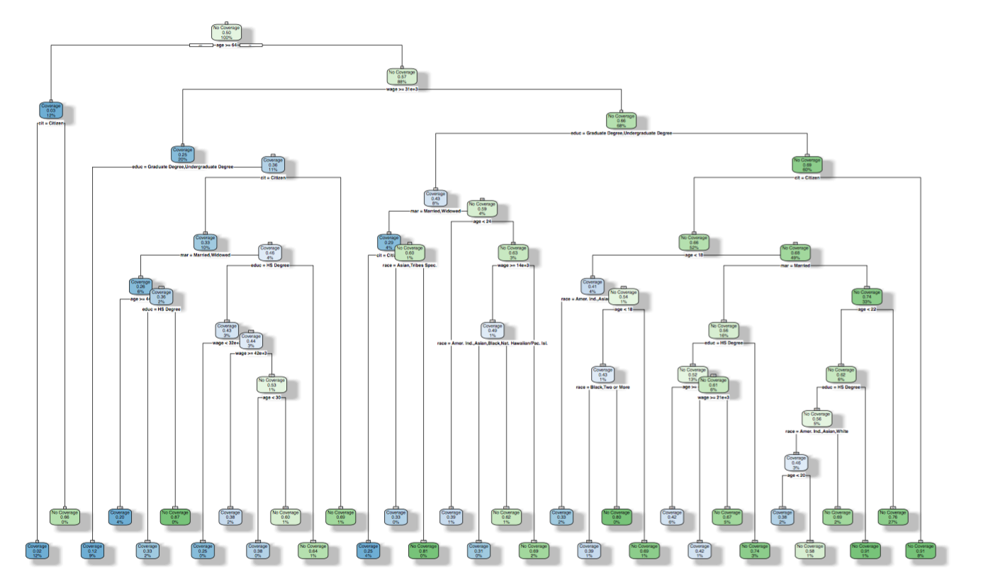
Trees can be grown until there are no more data points to split. What’s the problem with that?
Decision trees

Slide 61
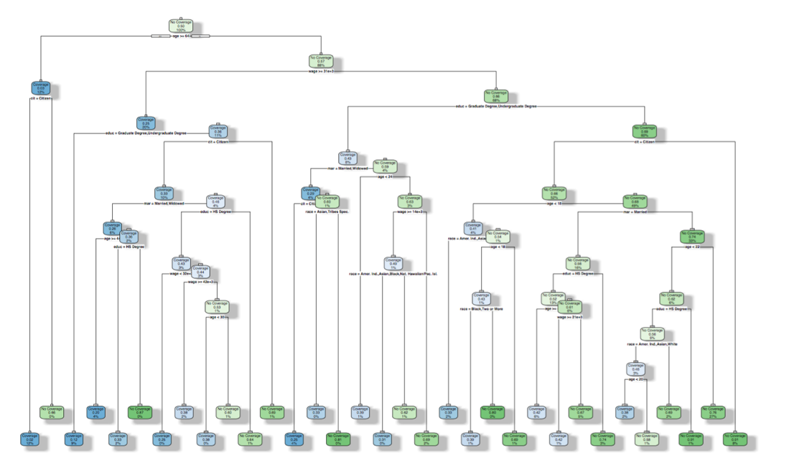
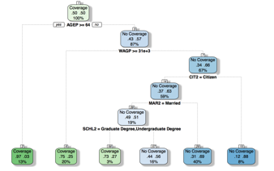
Decision trees can over fit easily.
The Bias-Variance Tradeoff
Trees that are built on too few observations may be built on noise. Trees that are overly simplified suffer from omitted variable bias.
Vs.
Classification

Slide 62
Tuning is the process of calibrating the model to minimize overfitting
Stop criteria vs. Pruning
Stop tree growth if criteria met
Prune or cut down the tree after full growth
Classification

Slide 63
Preventing [or minimizing] overfitting
Stop criteria vs. Pruning
Stop tree growth if criteria met
A node has fewer records than a pre-specific threshold;
The purity or information gain falls below a pre-specified level or is equal to zero;
The tree is grown to n-number of levels
Prune or cut down the tree after full growth
Calculate the tree’s error after each split
Prune tree at optimal number of nodes
Classification

Slide 64
There are issues though.
Stop criteria vs. Pruning
Stop criteria tend to under fit the tree.
Pruning is computationally costly (Complex trees take forever)
Classification

Slide 65
How do we know which variable matters the most?
Variable’s importance is the sum of all the contributions variable k makes towards predicting the target.
Basically the sum of all Gini purity values for whenever variable k caused a node split.
Decision trees

Slide 66
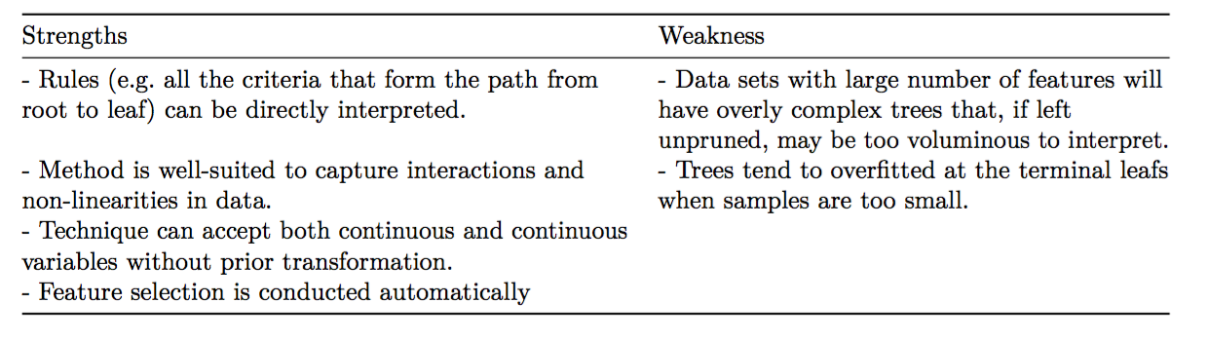
Decision Trees: Strengths and Weaknesses
Decision trees

Slide 67
CODE-ALONG
Decision trees

Slide 68
Roadmap
A Surprise
Motivation
Classification Preliminaries
Decision Trees
<Break>
Random Forests
Homework #3
Homework #4 – a head up
Intro to Data Science for Public Policy, Spring 2017

Slide 69
How does NOAA produce the cone of uncertainty?
Random Forests

Slide 70
How does NOAA produce the cone of uncertainty?
It’s the result of multiple models called an “ensemble”. The average model is likely to have a more accurate estimate than just one model alone.
Random Forests

Slide 71
ensemble
Decision tree – ensemble – ensemble - pen
Random Forests

Slide 72
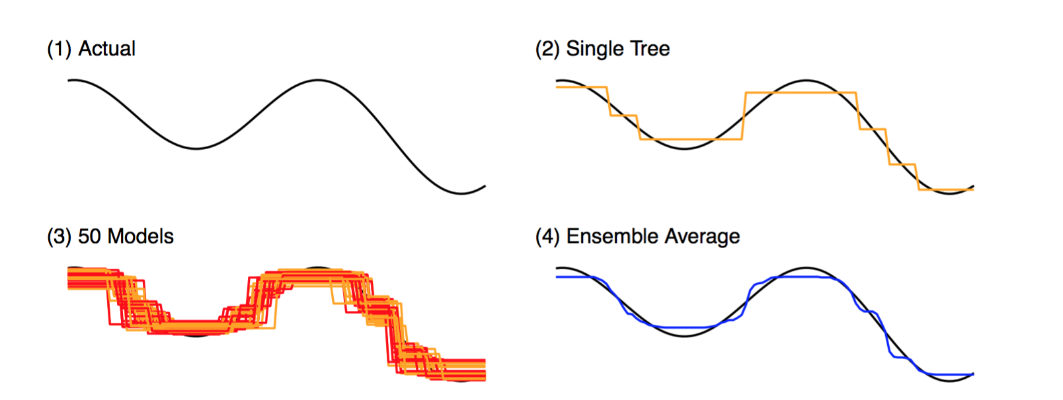
Random Forests

Slide 73
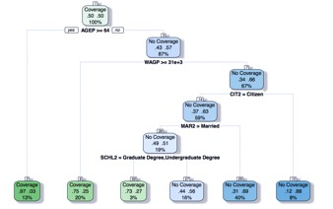
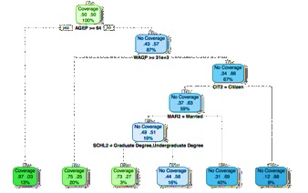
Random Forests are an extension of decision tree learning that relies on an ensemble of models to asymptotically predict targets.
Random Forests

Slide 74
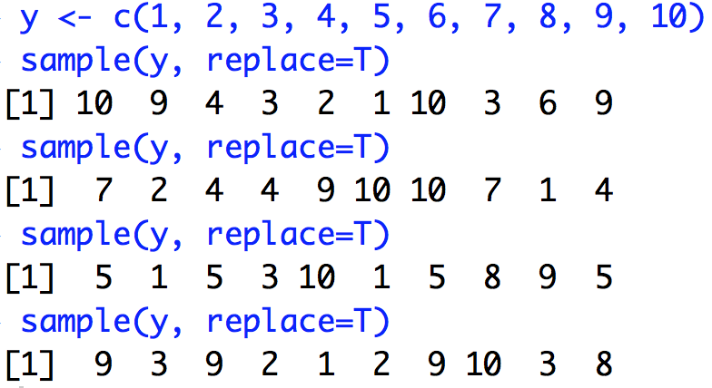
Concepts: Random Forests rely on fundamentals of Bootstrapping -- any process that involves sampling with replacement. This can help with characterizing uncertainty and improving the mean estimate.
Random Forests
Notes:
Sampling with replacement is like treating a sample as a population and helps for the natural weight of the data be reflected in a subsample

Slide 75
Aggregating the results of each bootstrap is called “Bagging” or “Bootstrap Aggregating”. Bagging is known as a “meta-algorithm” that relies on other models.
Random Forests
Notes:
Sampling with replacement is like treating a sample as a population and helps for the natural weight of the data be reflected in a subsample

Slide 76
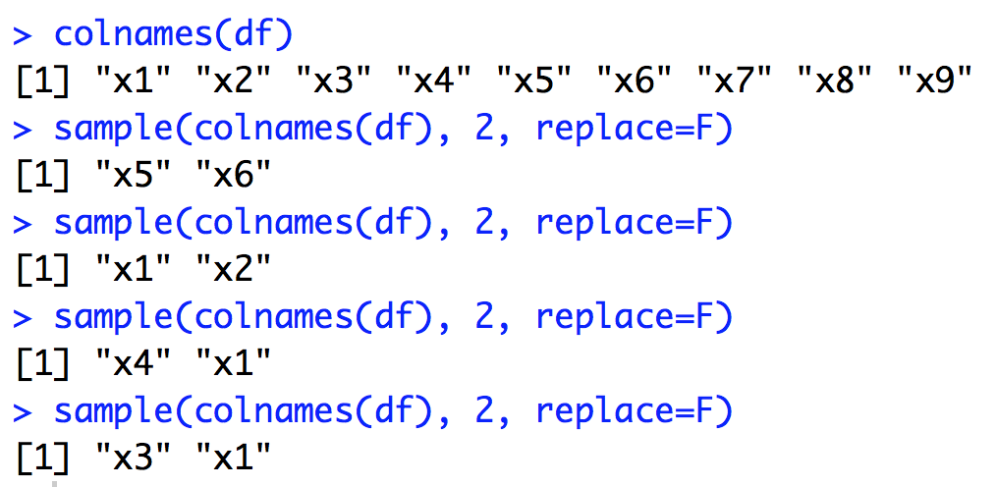
Variable sampling involves sampling from variables. At scale, a model where the specification is randomly selected has the same bias as any other model from the draw.
Random Forests

Slide 77
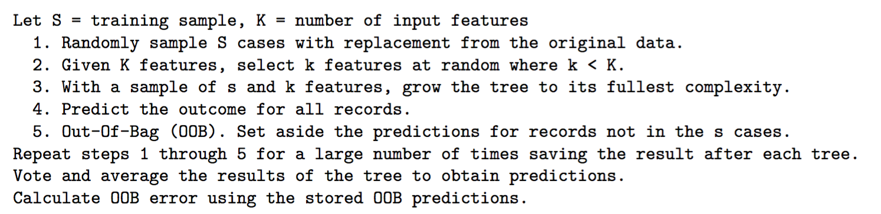
Random Forests involve growing a forest of decision trees where observations are bootstrapped and variables are sampled. Each tree is run unpruned.
The Pseudo code
Random Forests

Slide 78
What is OOB?
n
Full Sample
Bootstrap sample
Unique records in sample that were selected
OOB
Untouched in bootstrap
Random Forests

Slide 79
Why OOB?
n
Full Sample
Bootstrap sample
Unique records in sample that were selected
OOB
Train model on bootstrap
Test model on OOB
Untouched in bootstrap
Random Forests

Slide 80
Graphical Example: Iteration 0
 | X1 | X2 | X3 | X4 | X5 | X6
1
2
3
4
5
Random Forests

Slide 81
Graphical Example: Iteration 1
Selected
OOB
 | X1 | X2 | X3 | X4 | X5 | X6
1
2
3
4
5
Random Forests

Slide 82
Graphical Example: Iteration 2
Selected
OOB
 | X1 | X2 | X3 | X4 | X5 | X6
1
2
3
4
5
Random Forests

Slide 83
Graphical Example: Iteration N
Selected
OOB
 | X1 | X2 | X3 | X4 | X5 | X6
1
2
3
4
5
Random Forests

Slide 84
Model training
Training Sample
Tree 1
Tree 2
. . .
Tree N
Selected
Selected
Selected
OOB
OOB
OOB
Majority Voting
Random Forests

Slide 85
Tuning is the process of calibrating the model to minimize overfitting
# of trees vs. # of variables
The number of trees is important for deriving stable estimates of variable importance.
Beyond a certain threshold, more trees doesn’t improve accuracy.
# of variables influences the depth and richness of models
Variable importance is interpreted using the Mean Decrease Gini
Classification

Slide 86

Random Forests are the technique of choice for most Kaggle competitions.
Random Forests

Slide 87
CODE-ALONG
Random Forests

